Slide 1
Ezekiel 8-10
“And He said to me, “Go in and see the wicked abominations that they are committing here.” (Ezekiel 8:9)

Slide 2
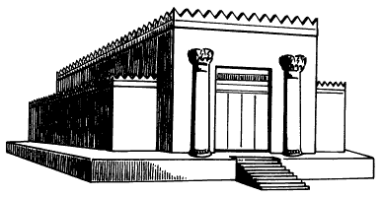
Ezekiel 8: Jerusalem and Temple Vision
“Brought me in visions of God to Jerusalem” (8:1-4)
THE DEFILEMENT OF THE TEMPLE (8:5-18)
Temple Activities: What Ezekiel SAW (8:5-13)
People’s Attitude: What Ezekiel HEARD (8:13)
They have gone too far! (8:14-17)
“Yet you will see still greater abominations…” (8:6, 13, 15)
“They are putting the twig to their nose…” (8:17b)
God’s attitude toward the people (8:18)

Slide 3
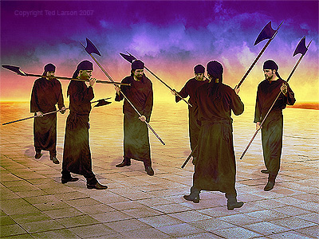
Ezekiel 9: Vision of the Executioners
“Draw near O Executioners…” (9:1-2)
THE GLORY OF THE LORD… ON THE MOVE (9:3A)
THE MARKING… OF THE RIGHTEOUS (9:3B-4)
UTTER DESTRUCTION UPON “THE OTHERS” (9:5-7)
EZEKIEL’S CONCERN (9:8)
GOD’S RESPONSE TO EZEKIEL (9:9-10)
MISSION ACCOMPLISHED (9:11)

Slide 4
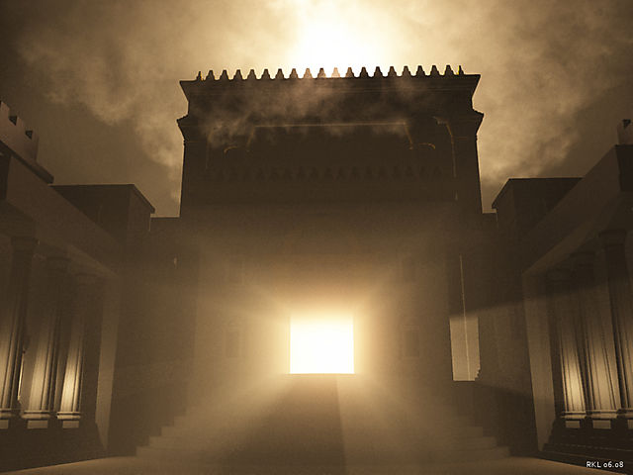
Ezekiel 10: Vision of the Glory of the Lord Departing
“Then the Glory of the Lord departed…” (10:18)
COALS OF FIRE SCATTERED ON THE CITY (10:1-2)
THE GLORY OF THE LORD… ON THE MOVE (10:3-5)
THE GLORYAND POWER OF GOD (10:6-17)
GOD DEPARTS THE TEMPLE (10:18-22)

